Slide 1
BIOEN 438 / BIOEN 538 Biomedical Control Systems Engineering Lecture 1: Course Introduction
Joseph L. Hellerstein (Part 1)
Herbert M Sauro (Part 2)
January 5, 2026
Department of BioEngineering
Notes:
Diverse students. Some with bio-backgrounds; some without. Some with CS background; some with very limited. Two separate courses combined because of a substantial shared curriculum.

Slide 2
Agenda
What is control engineering and why it’s important
Course overview
Control system concepts
Controller design (Colab Notebook)

Slide 3
Part 1 Instructor
Joseph Hellerstein, Senior Fellow eScience Institute, Affiliate Professor CSE & Bioengineering
PhD in Computer Science
Industry (30+ years): IBM Research, Microsoft, Google
Mathematical models of distributed computing systems
Research focus: Modeling biological systems
Mathematical techniques
Software tools

Slide 4
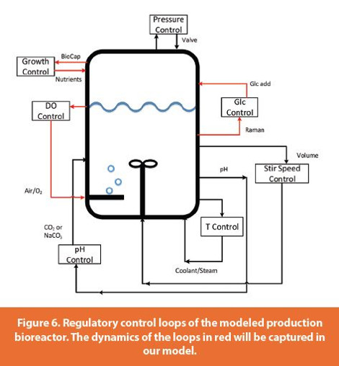
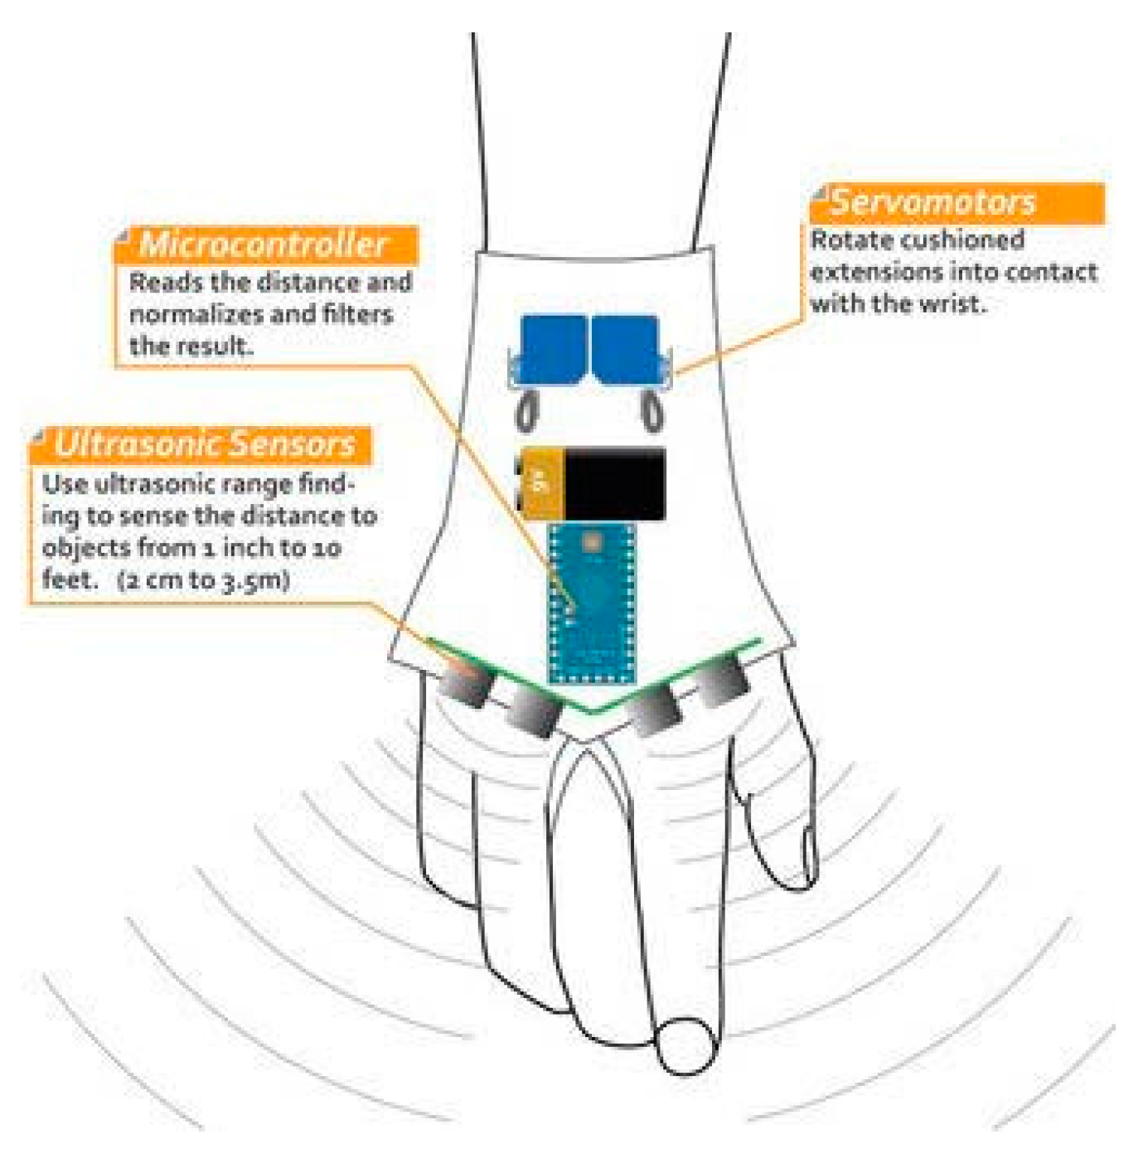
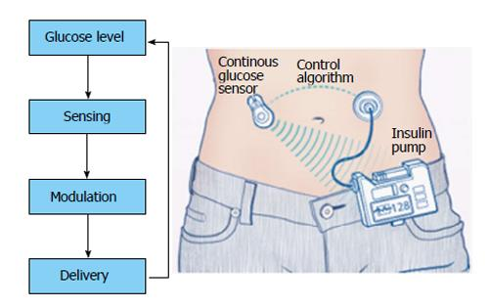
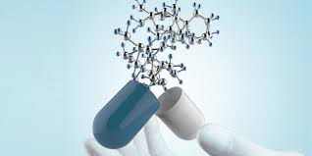
Why Control Engineering?
Bioreactor Control
Medical Device Control
Insulin Control
Regulate outputs such as bacterial density, hand motion, insulin levels
Ensure bounded inputs produce bounded outputs
Satisfy other requirements such as short settling times and no oscillations

Slide 5
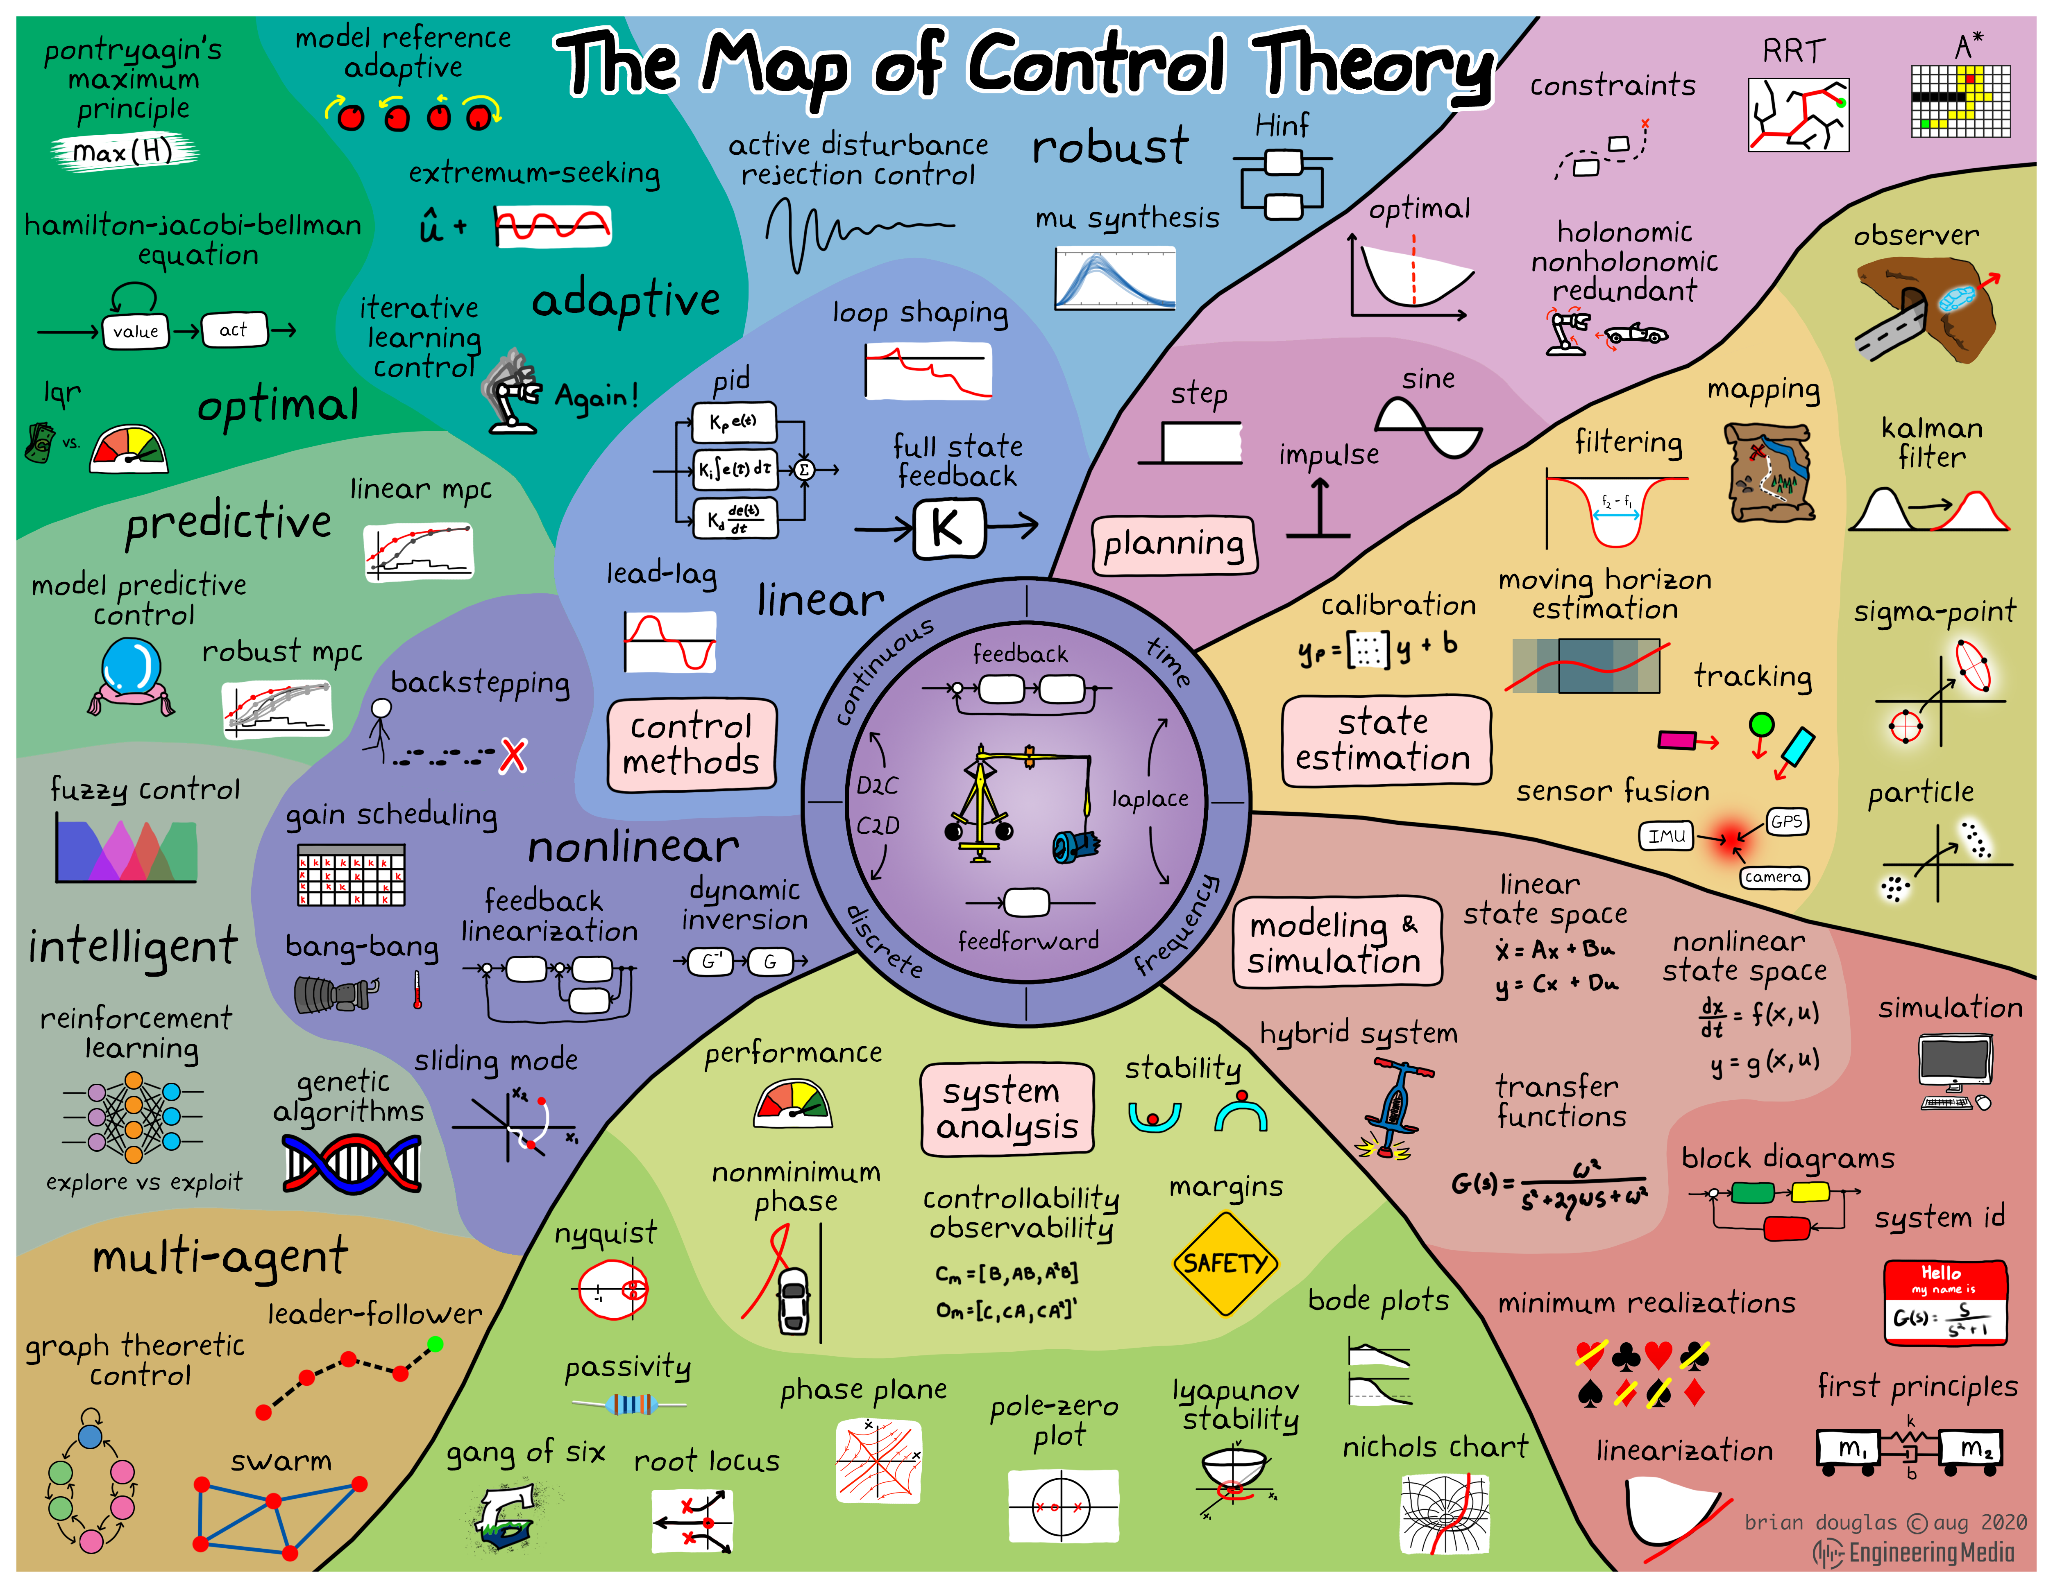
Control theory is a branch of applied mathematics that deals with the design of control policies for actuated dynamical systems. Control engineering is a cross-discipline field which applies control theory to a wide range of systems such as industrial plants, aerospace, robotics and more.
Brian Douglas

Slide 6
Structure of the Course
Part 1: Control Engineering Fundamentals
Control concepts and objectives
Controllability analysis
LTI theory & system identification
Design & evaluation
Part 2: Control Design for Chemical Systems

Slide 7
Part 1 Grading: 50% of Course Grade
Homework (4 assignments): 20%
Final project: 30%
End-to-end analysis and design of a feedback control of an SBML model

Slide 8
Submitting Homework
Create your folder here. Only you and the instructors have permissions for the folder.
Upload your assignment to the folder before the due date.

Slide 9
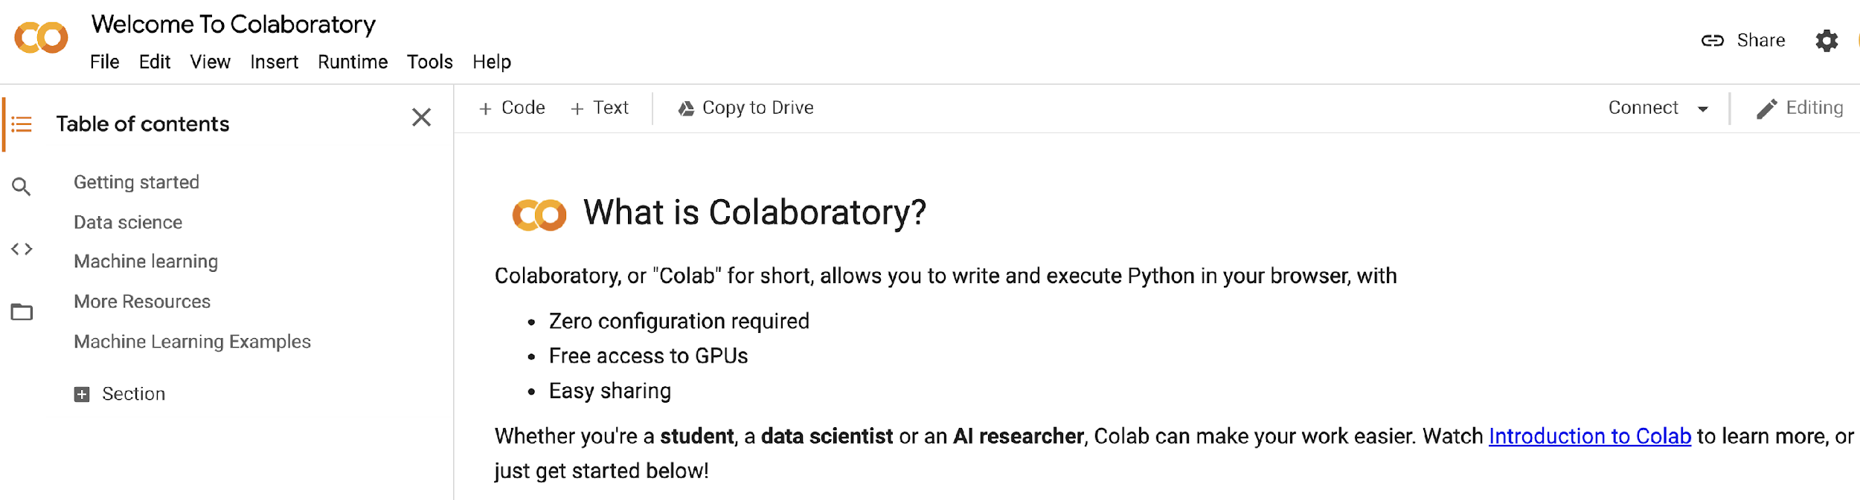
Getting Google Colaboratory (Colab)
We will use Google Colab for in-class presentation and student homeworks.
Actions: Set up Colab now on your Google Account.

Slide 10
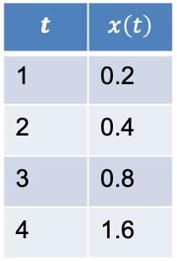
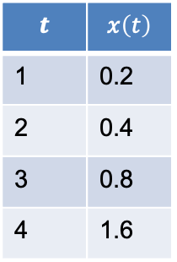
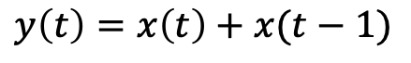
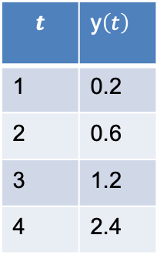
Signals & Systems
$$t$$ | $$x\left(t\right)$$
1 | 0.2
2 | 0.4
3 | 0.8
4 | 1.6
Signal
a time series
System
Transforms one signal(s) into another signal(s)
$$t$$ | $$x\left(t\right)$$
1 | 0.2
2 | 0.4
3 | 0.8
4 | 1.6
$$t$$ | y$\left(t\right)$
1 | 0.2
2 | 0.6
3 | 1.2
4 | 2.4
$$y\left(t\right)=x\left(t\right)+x(t−1)$$

Slide 11
Open Loop System (OLS)
A system/process we are given
Has measured outputs we want to control
Ex: blood glucose
Has control inputs that influence the measured output
Ex: insulin
control input u(t)
OLS
measured output y(t)

Slide 12
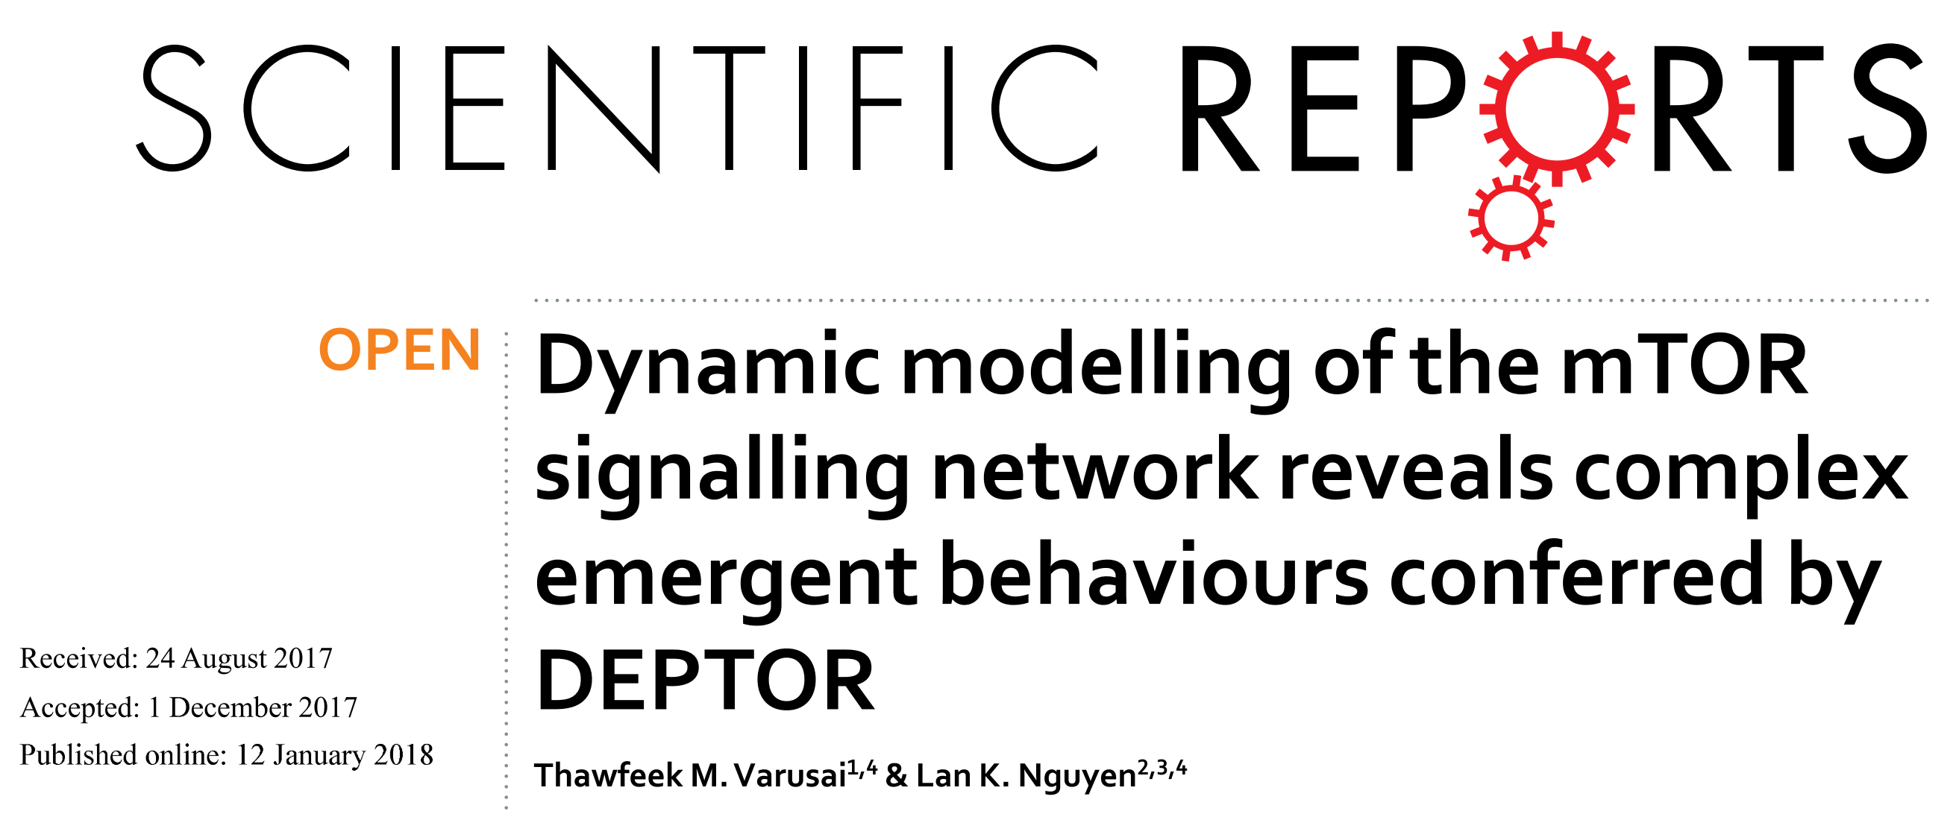
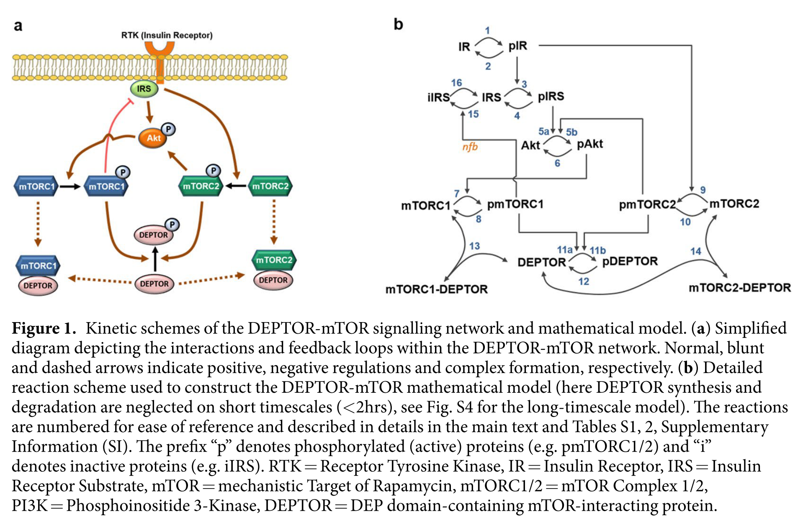
An Example: mTOR Signaling

Slide 13
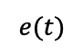

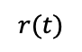
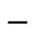
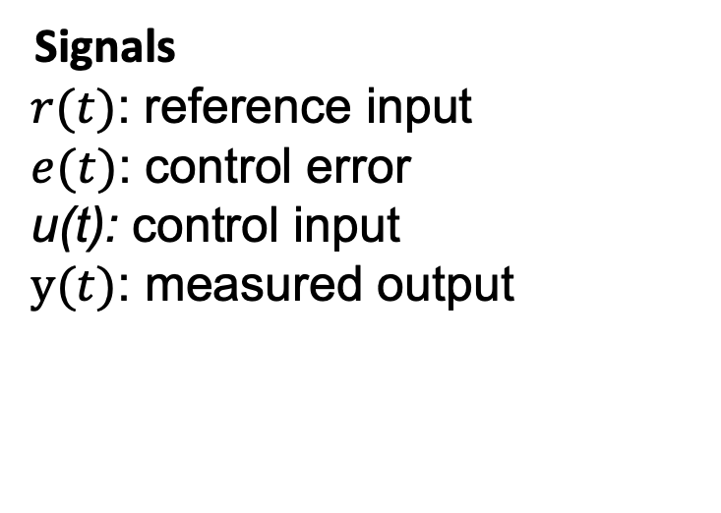
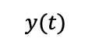
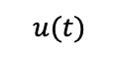
Closed Loop System (CLS)
$$r(t)$$
$$e(t)$$
$$u(t)$$
$$y(t)$$
Controller
C
C
+
$$OLS$$
+
$$−$$
Signals
$r(t)$: reference input
$e(t)$: control error
u(t): control input
$y(t)$: measured output
Systems
Open loop system (OLS)
Controller
Compensation (C)
Notes:
Why doesn’t a filter help with measurement noise? Verify transfer functions.

Slide 14
Control Design Exercise

Slide 15
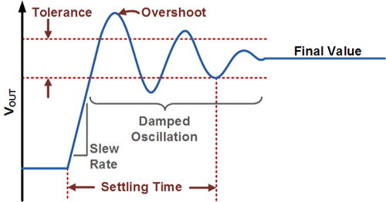
Control Objectives
Stable: bounded input produces a bounded output (BIBO)
Final value is within tolerance
Short settling time
Minimum or now oscillations or overshoot/undershoot

Slide 16
System Description & Control Objectives
What is the open loop system?
What is the output (measured output) you want to control?
Requirements for effective control.
How accurately must the controller track the objective (bias)?
How quickly must the controller adjust after a disruption (settling time)?
Tolerance of oscillations, overshoot, undershoot?

Slide 17
Challenges in Control Engineering of Biological Systems
Homeostasis is not our friend.
Can be difficult to find an input that affects the output
Complex activation and inhibition makes it difficult to know the direction of effects
Difficult to accurately model biological systems.

Slide 18
Resources
Python
Python programming
Python Data Science Handbook
Python for control engin eering (Part VIII)
Control Engineering
Modern Control Engineering, Ogata
Linear Systems - Theory and Design, Chi-Tsong Chen
State Space Design (YouTube), Jake Abbott (University of Utah)
YouTube playlist for control engineering
Steve Brunton Control Boot Camp
Control Systems Design Online

Slide 19
Software
The class will feature in-class exercises, so please bring a laptop to class
Software: Tellurium (http://tellurium.analogmachine.org/)
For detailed installation instructions see https://github.com/sys-bio/tellurium#installation-instructions
For a huge database of curated models see:
https://www.ebi.ac.uk/biomodels/
Other packages
control – CalTech package for control systems design
controlSBML – Control design with SBML models

